Slide 1
A3 2015
Question 5

Slide 2
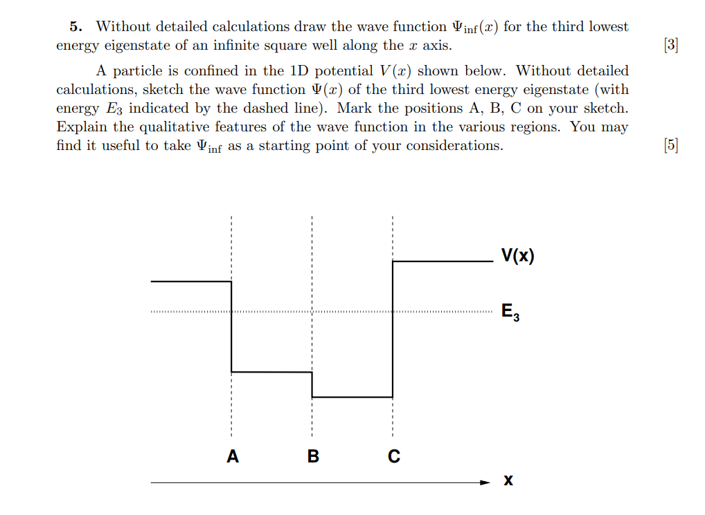
A3 2015

Slide 3

First part
Without detailed calculation draw the wavefunction $Ψ_{inf}(x)$ for the third lowest energy eigenstate of an infinite square well along the $x$ axis. [3]

Slide 4
First part
Without detailed calculation draw the wavefunction $Ψ_{inf}(x)$ for the third lowest energy eigenstate of an infinite square well along the $x$ axis. [3]
The wavefunction must obey the TISE. Given the potential goes to infinity outside the well, the wavefunction must go to 0 at the boundaries.

Slide 5
First part
Without detailed calculation draw the wavefunction $Ψ_{inf}(x)$ for the third lowest energy eigenstate of an infinite square well along the $x$ axis. [3]
The wavefunction must obey the TISE. Given the potential goes to infinity outside the well, the wavefunction must go to 0 at the boundaries.
As $x→0,a$, $V→∞, ∴$ $Ψ→0.$
Due to the parity symmetry in the potential itself, we know the wavefunctions must also have odd or even parity symmetry.

Slide 6
First part
Without detailed calculation draw the wavefunction $Ψ_{inf}(x)$ for the third lowest energy eigenstate of an infinite square well along the $x$ axis. [3]
As $x→0,a$, $V→∞, ∴$ $Ψ→0.$
Due to the parity symmetry in the potential itself, we know the wavefunctions must also have odd or even parity symmetry.
Odd or even symmetry with respect to the potential.
We know that each state is labelled with an integer n, and that each one corresponds to the number of half-wavelengths that can fit in the well.

Slide 7

First part
Without detailed calculation draw the wavefunction $Ψ_{inf}(x)$ for the third lowest energy eigenstate of an infinite square well along the $x$ axis. [3]
As $x→0,a$, $V→∞, ∴$ $Ψ→0.$
Odd or even symmetry with respect to the potential.
Each state labelled by an integer, number of half-wavelengths.
We know that each state is labelled with an integer n, and that each one corresponds to the number of half-wavelengths that can fit in the well.
$$−\frac{ℏ^{2}}{2m}\frac{∂^{2}}{∂x^{2}}Ψ=EΨ$$
$\frac{∂^{2}Ψ}{∂x^{2}}+\frac{ 2mE }{ℏ^{2}}Ψ=0$ : Harmonic solutions
Basic TISE calculation:

Slide 8
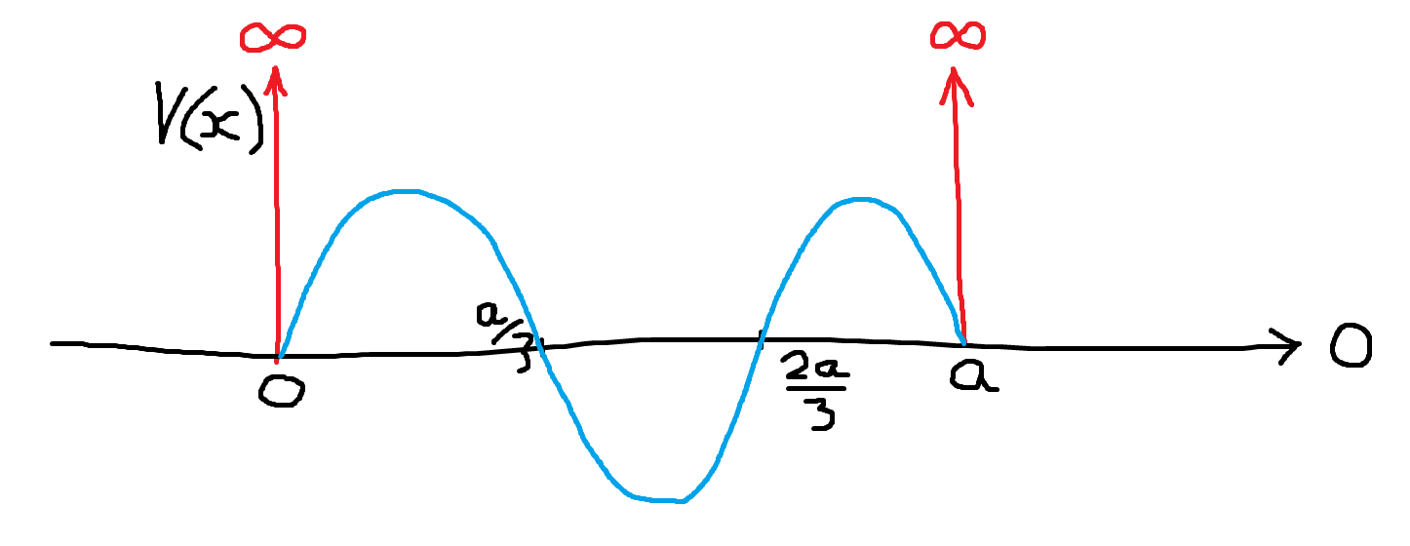

First part
Without detailed calculation draw the wavefunction $Ψ_{inf}(x)$ for the third lowest energy eigenstate of an infinite square well along the $x$ axis. [3]
Symmetry axis of wavefunction
3rd energy eigenfunction labelled with n=3, so 3 half-wavelengths of equal magnitude can fit in the well.
Thus, it has $n−1=3$ nodes.

Slide 9

Second part
A particle is confined in the 1D potential $V\left(x\right)$ shown below. Without detailed calculations, sketch the wave function $Ψ\left(x\right)$ of the third lowest energy eigenstate (with the enrgy $E_{3}$ indicated by the dashed line). Mark the positions A, B, C on your sketch. Explain the qualitative features of the wave function in the various regions. You may find it useful to take $Ψ_{inf}$ as a starting point of your considerations. [5]

Slide 10
Second part
The wavefunction must be a solution to the TISE, and takes the form of real or imaginary exponential functions, depending on the sign of E-V in the region.

Slide 11
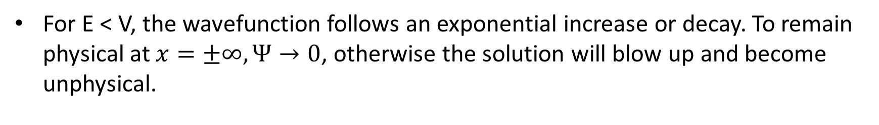
Second part
Wavefunction is harmonic or exponential depending on sign of E-V.
The wavefunction must be a solution to the TISE, and takes the form of real or imaginary exponential functions, depending on the sign of E-V in the region.
For E < V, the wavefunction follows an exponential increase or decay. To remain physical at $x=±∞, Ψ→0$, otherwise the solution will blow up and become unphysical.

Slide 12
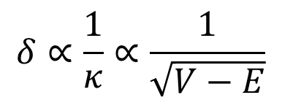
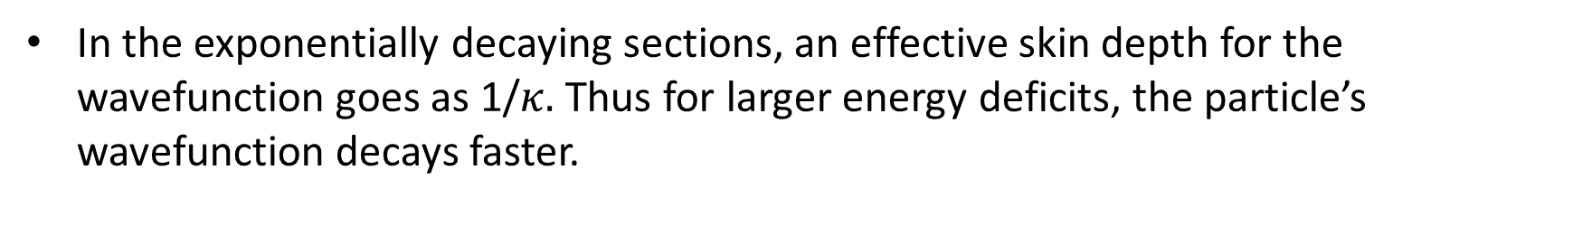
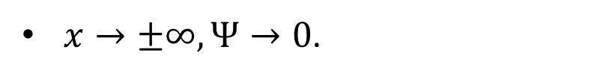
Second part
Wavefunction is harmonic or exponential depending on sign of E-V.
$x→±∞, Ψ→0$.
For E < V, the wavefunction follows an exponential increase or decay. To remain physical at $x=±∞, Ψ→0$, otherwise the solution will blow up and become unphysical.
In the exponentially decaying sections, an effective skin depth for the wavefunction goes as 1/$κ.$ Thus for larger energy deficits, the particle’s wavefunction decays faster.
$$δ∝\frac{1}{κ}∝\frac{1}{\sqrt{V−E}}$$

Slide 13
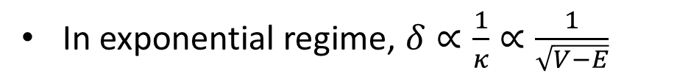

Second part
Wavefunction is harmonic or exponential depending on sign of E-V.
$x→±∞, Ψ→0$.
In exponential regime, $δ∝\frac{1}{κ}∝\frac{1}{\sqrt{V−E}}$
In the exponentially decaying sections, an effective skin depth for the wavefunction goes as 1/$κ.$ Thus for larger energy deficits, the particle’s wavefunction decays faster.
For E > V, the wavefunction takes the form of monochromatic harmonic functions (within a region). A greater difference in energy between the particle and the potential will result in a shorter wavelength.
$$δ∝\frac{1}{κ}∝\frac{1}{\sqrt{V−E}}$$
$$λ∝\frac{1}{k}∝\frac{1}{\sqrt{E−V}}$$

Slide 14
Second part
Wavefunction is harmonic or exponential depending on sign of E-V.
$x→±∞, Ψ→0$.
In exponential regime, $δ∝\frac{1}{κ}∝\frac{1}{\sqrt{V−E}}$
In harmonic regime, $λ∝\frac{1}{k}∝\frac{1}{\sqrt{E−V}}$
For E > V, the wavefunction takes the form of monochromatic harmonic functions (within a region). A greater difference in energy between the particle and the potential will result in a shorter wavelength.
$Ψ$ must remain continuous at all points in space.
$Ψ′$ must remain continuous at all points in space.
$$λ∝\frac{1}{k}∝\frac{1}{\sqrt{E−V}}$$

Slide 15
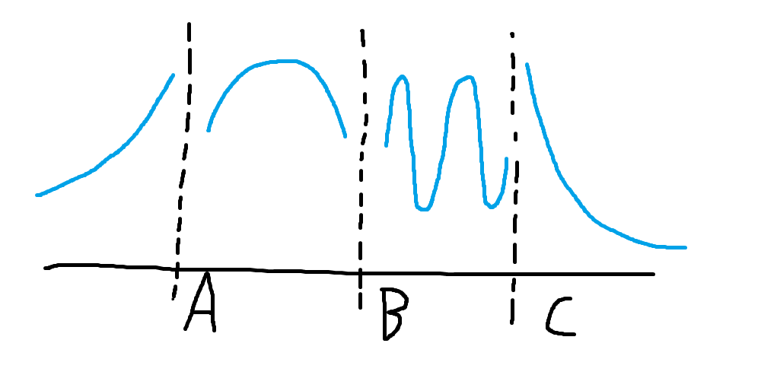
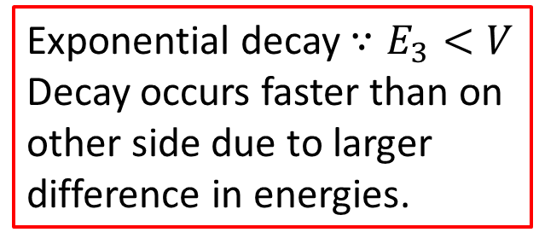
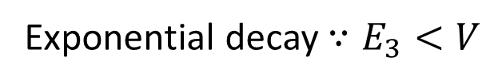
Second part
Exponential decay $∵E_{3}<V$
Exponential decay $∵E_{3}<V$
Decay occurs faster than on other side due to larger difference in energies.

Slide 16
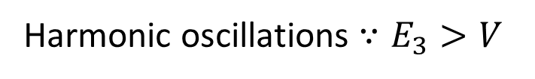
Second part
Harmonic oscillations $∵E_{3}>V$
Shorter wavelength than in the other region because the energy difference is greater.

Slide 17
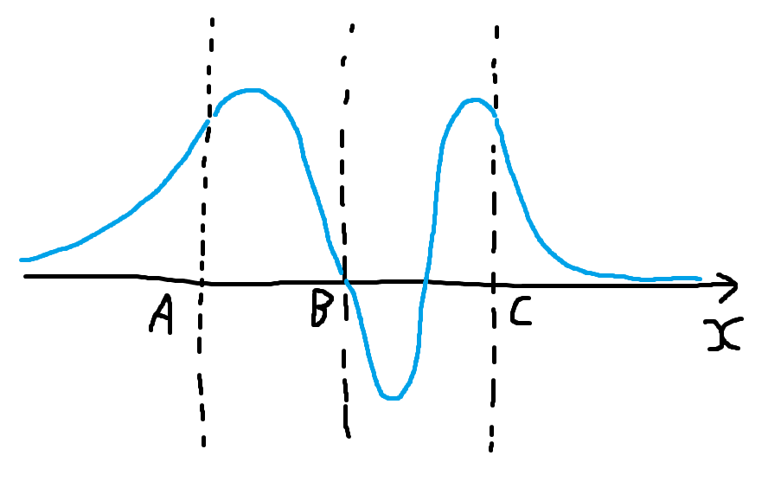
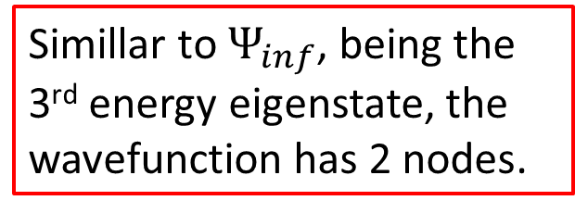
Second part
Simillar to $Ψ_{inf}$, being the 3rd energy eigenstate, the wavefunction has 2 nodes.

